Slide 1
Capstone Project Report
"Unveiling COVID-19's Impact: Data Analytics on Death and Vaccination Datasets."
by : Samanta Rana ; #0810971
to : Prof. Savita Shehrawat

Slide 2

Table of Content
Abstract
Research Questions
Introduction to Dataset
Data Dictionary
Statistical Description of Data
Snapshots of Literature Review
Data Preprocessing
Insights from Data Analysis
Effectiveness of Research Report
References

Slide 3
Abstract :
This research study presents a comprehensive analysis of a global COVID-19 dataset, encompassing COVID-19 deaths and vaccinations, as well as factors such as hospital capacity, bed availability, vaccination success rates, and survival rates. The objective is to examine the interplay between these significant factors and understand their impact on the COVID-19 pandemic worldwide.
The findings of this research have implications for policymakers, healthcare professionals, and public health organizations worldwide. The insights derived from this analysis can contribute to informed decision-making, resource allocation, and the development of effective strategies to combat the ongoing COVID-19 crisis. Ultimately, the research aims to provide valuable insights into mitigating the impact of the pandemic and improving global health outcomes.

Slide 4
Research Questions :
1. Can the current vaccination rates and success rates be used to predict future trends in COVID-19 deaths globally?
2. How does the strain on healthcare systems affect COVID-19 outcomes and survival rates?
3. What insights can be derived from the analysis to inform decision-making and the development of effective strategies to combat the ongoing COVID-19 crisis?
4. How can the insights from the analysis be leveraged to develop predictive models that aid decision-making, resource allocation, and the formulation of effective strategies to combat the ongoing COVID-19 crisis globally
5. Can we develop a predictive model that takes into account hospital capacity, including available beds and ICU capacity, to estimate the impact of COVID-19 on healthcare systems and predict future strain levels?

Slide 5
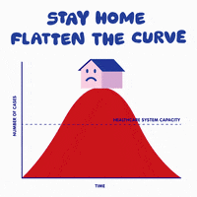

Introduction to Dataset :
The dataset at the heart of our study stands as a testament to the magnitude of the pandemic's impact, encompassing an impressive 10,868,428 instances. Each instance represents a unique snapshot of time, capturing various attributes that detail the evolution of the pandemic from its inception in January 2020 to the present day. The richness of this dataset empowers us to delve into a plethora of factors that have shaped the trajectory of Covid-19, allowing us to draw meaningful correlations and glean profound insights.
Crucial to our investigation are the two pivotal dimensions:
Covid Deaths and Covid Vaccinations.

Slide 6
Data Dictionary :
S. no | Column names | Non-null count | DTypes
1. | iso_code | 313267 | category
2. | continent | 298368 | category
3. | location | 313267 | category
4. | date | 313267 | category
5. | tests_units | 313267 | category
S. no | Column names | Non-null count | DTypes
1. | population | 277045 | numerical
2. | total_cases | 256295 | numerical
3. | total_deaths | 79387 | numerical
4. | total_tests | 304385 | numerical
5. | new_cases | 304385 | numerical
6. | new_cases_per_million | 303121 | numerical
7. | new_cases_smoothed_per_million | 75403 | numerical
8. | new_tests | 79387 | numerical
9. | new_tests_per_thousand | 75403 | numerical
10. | total_tests_per_thousand | 103965 | numerical
11. | new_tests_smoothed | 103965 | numerical
cont…

Slide 7
Statistical Description of the Dataset
 | mean | std | min | 25% | 50% | 75% | max | De Description
total_cases | 5813693.1 | 36255067.6 | 1.0 | 6607.0 | 62627.0 | 647602.0 | 766894311.0 | total number of covid cases
new_cases | 10679.3 | 102719.6 | 0.0 | 0.0 | 16.0 | 516.0 | 7460817.0 | number of new cases
new_cases_smoothed | 10722.1 | 99962.9 | 0.0 | 1.0 | 37.1 | 625.6 | 6410666.9 | average value of daily count
total_deaths | 80886.6 | 417669.6 | 1.0 | 122.0 | 1237.0 | 10711.0 | 6935876.0 | number of total deaths
new_deaths | 95.2 | 599.1 | 0.0 | 0.0 | 0.0 | 6.0 | 20027.0 | daily count of deaths
new_deaths_smoothed | 95.6 | 589.7 | 0.0 | 0.0 | 0.3 | 6.6 | 14677.9 | average of daily count of deaths
total_cases_per_million | 88706.4 | 139152.2 | 0.0 | 2064.9 | 21312.0 | 109074.3 | 737554.5 | number of total cases
new_cases_per_million | 161.1 | 1124.2 | 0.0 | 0.0 | 2.3 | 67.7 | 228872.0 | dfhf number of new cases per million
new_cases_smoothed_per_million | 161.8 | 632.9 | 0.0 | 0.2 | 10.5 | 102.3 | 37241.8 | averaged # new cases per million
total_deaths_per_million | 814.3 | 1056.2 | 0.0 | 51.1 | 339.8 | 1248.2 | 6477.6 | nu number of total deaths per million
new_deaths_per_million | 1.0 | 4.7 | 0.0 | 0.0 | 0.0 | 0.4 | 603.7 | daily count of deaths
new_deaths_smoothed_per_million | 1.0 | 2.9 | 0.0 | 0.0 | 0.0 | 0.7 | 148.6 | daily count of deaths per million
cont…

Slide 8
Literature Review :
COVID-19 Case and Mortality Patterns
COVID-19 Testing and Positivity Rates
COVID-19 Vaccination Efforts and Success
Socio-Demographic and Healthcare Factors
Excess Mortality Analysis
Predicting Future Trends in COVID-19 Deaths Based on Vaccination Rates and Success
and research question perspective…

Slide 9


Data Analysis Methodology

Slide 10
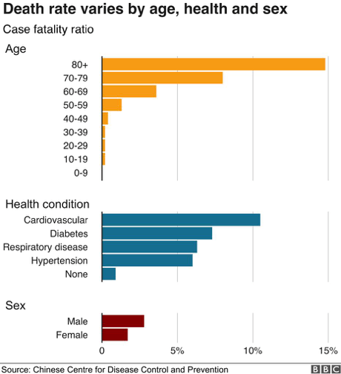

Slide 11
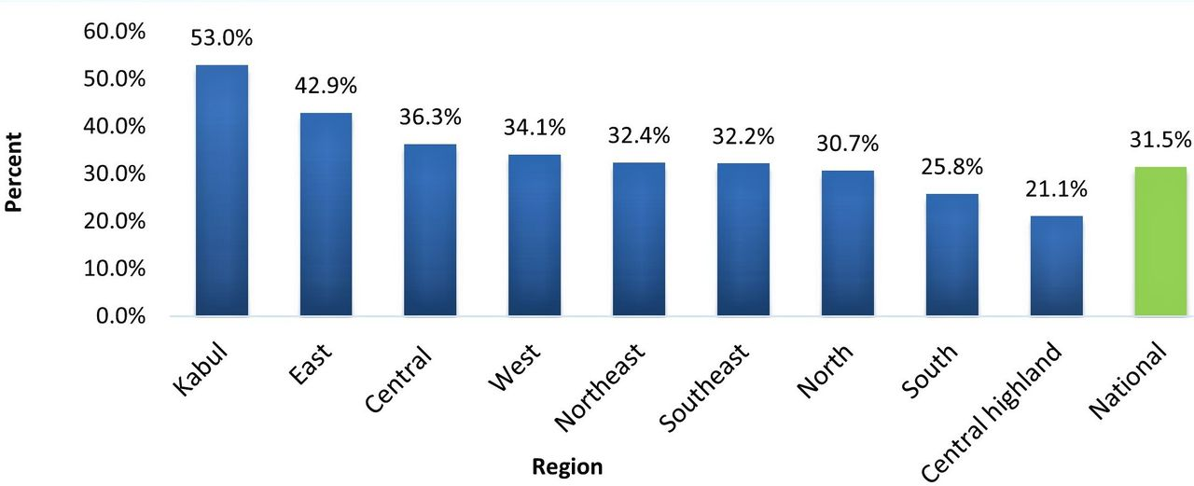
Statistics of Afganistan

Slide 12
Data Preprocessing :
The dataset in concern contains numerous null values, count is different for varied fields, and hence the handling of null values is also different for all the fields. Also, since the dataset contain over 3 million entries, with the scope of complexity and chances of loss of data, complete data at once is not cleaned rather the fields required as per the research questions is cleaned accordingly.
1) to eradicate the null values for the column = ‘population’, firstly the data is divided nation-wise and then the mean of the national population is used to fill the null values,
on the other hand,
2) for filling up the missing age of the demographic from the column = ‘age’, the dataset is divided into sub-groups of age and then median is taken to fill up the null values of the age.

Slide 13
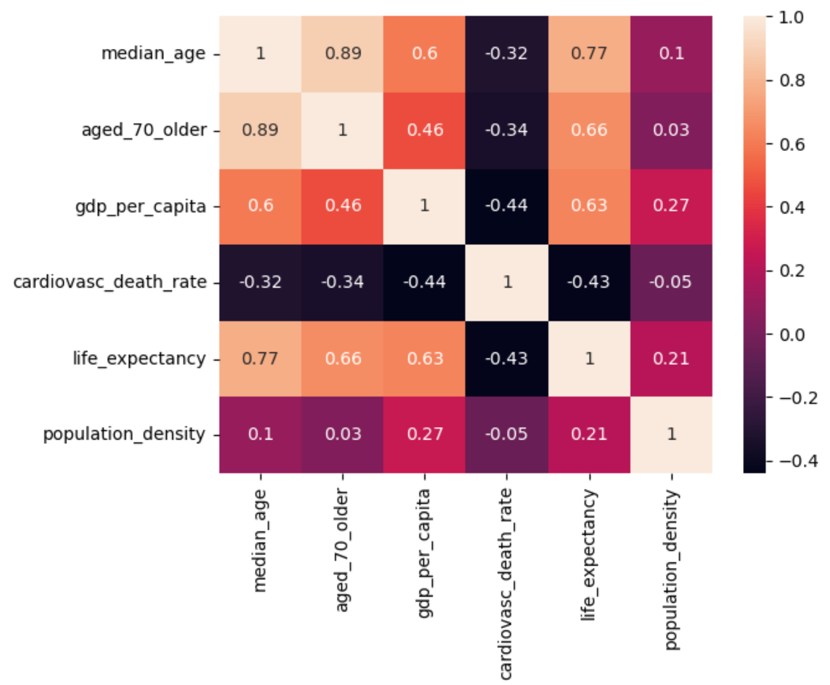
Data Standardization :
Heat map to analyze the correlation among input and output variables to get an idea about the relationships about to be established in further research.

Slide 14
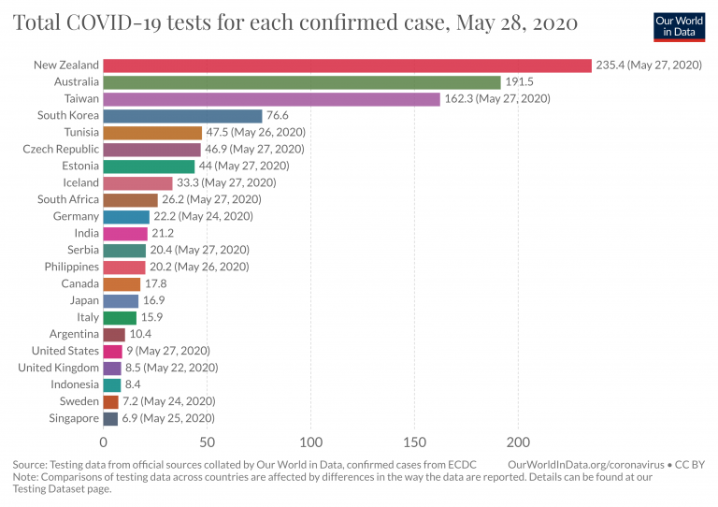



Slide 15
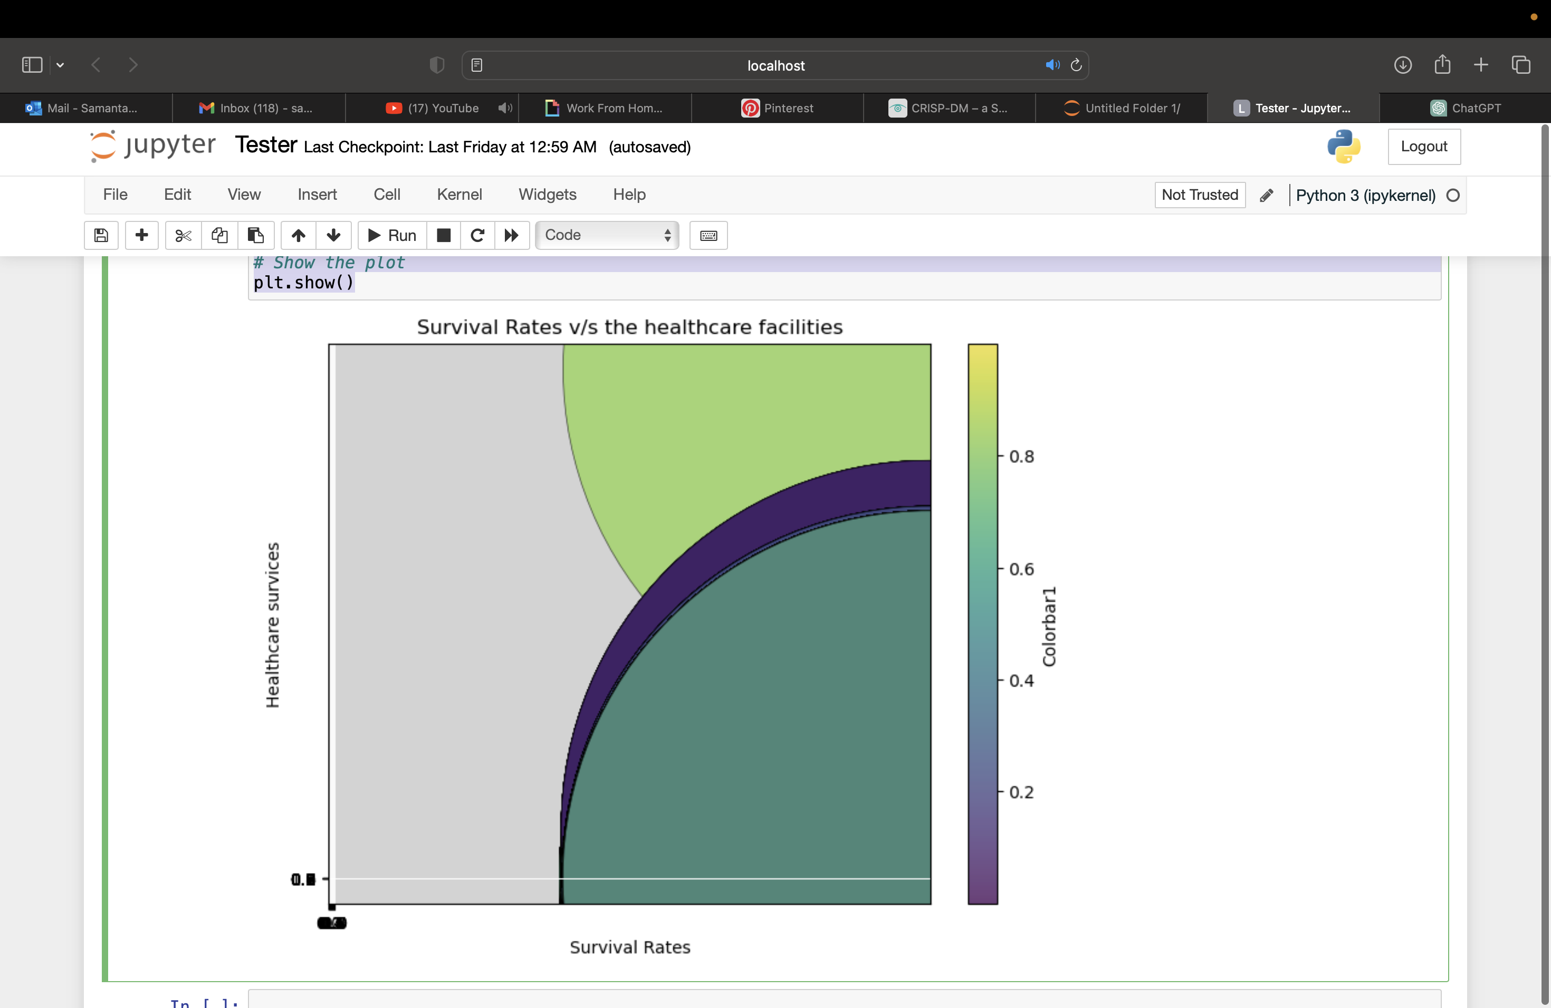
Impact of Healthcare System Strain on COVID-19 Outcomes and Survival Rates

Slide 16
Inferences :
location | Afghanistan
date | 2020-03-25
total_cases | 42.0
total_deaths | 1.0
Death_Percentage | 2.380952
location | Europe
date | 2020-08-10
total_cases | 3024803.0
total_deaths | 218887.0
Death_Percentage | 7.236405

Slide 17
The table representing the total death count all around the globe
TotalDeathCount
 | TotalDeathCount
location
United States | 1127152.0
Brazil | 702421.0
India | 531843.0
Russia | 398919.0
Mexico | 334079.0
United Kingdom | 225852.0
Peru | 220561.0
Italy | 190242.0
Germany | 174032.0
France | 163437.0
Indonesia | 161701.0
Iran | 146230.0
Colombia | 142741.0

Slide 18
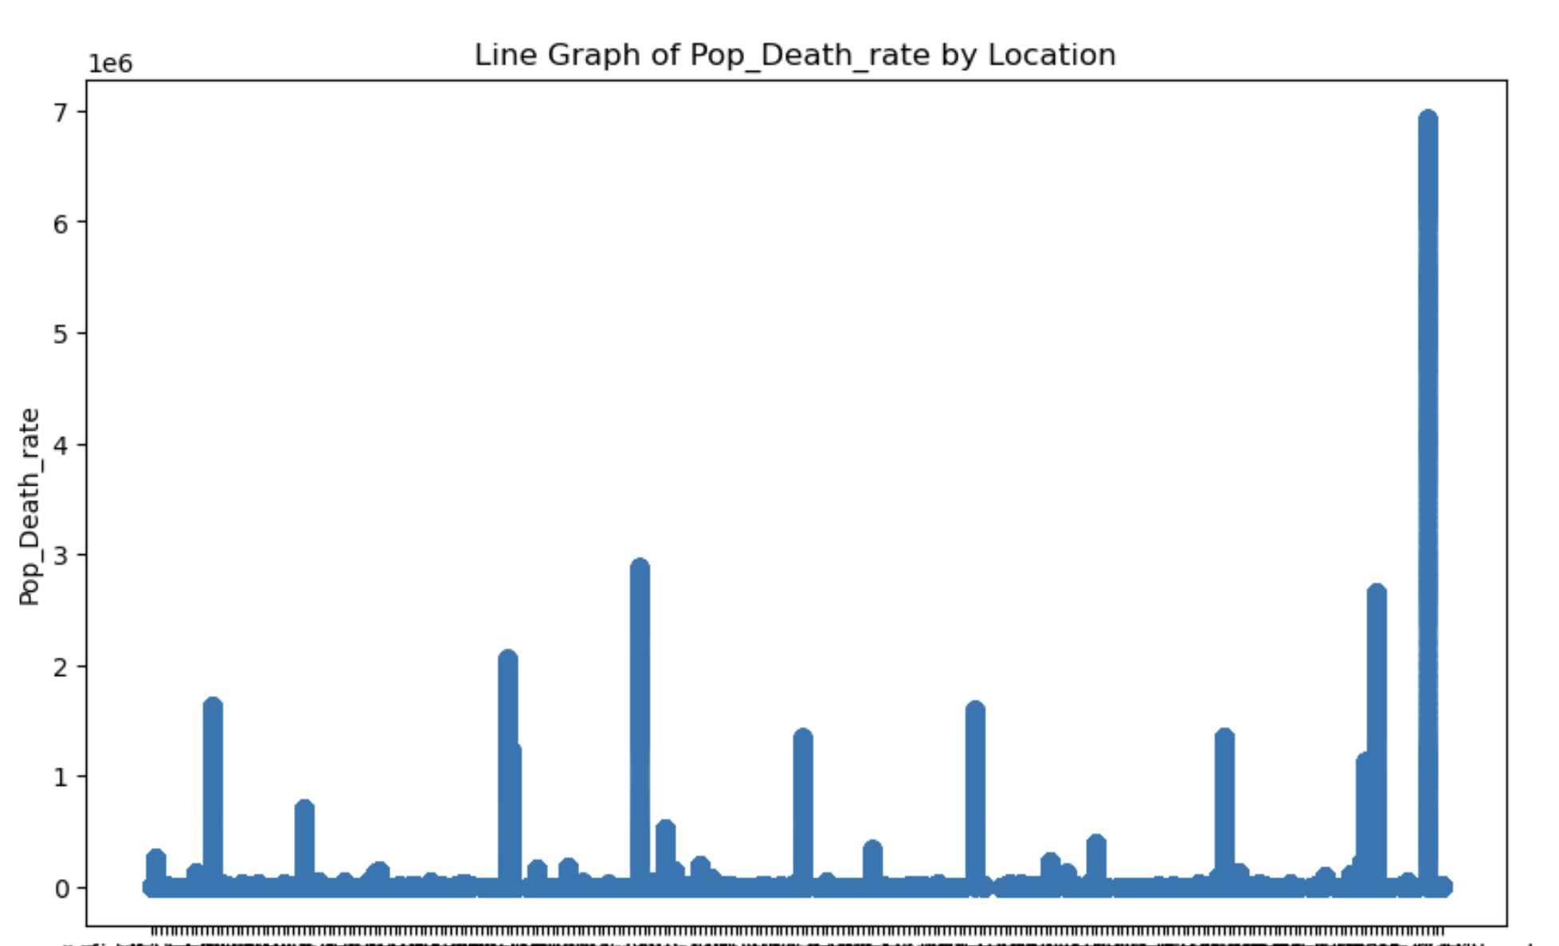

Slide 19
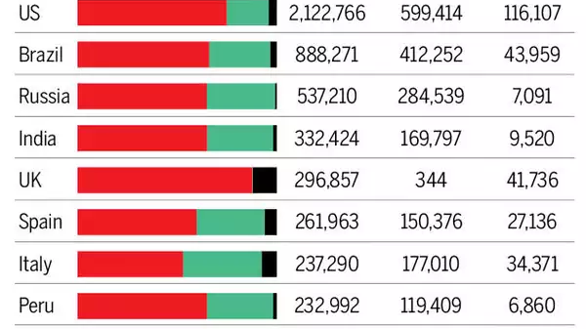

Slide 20
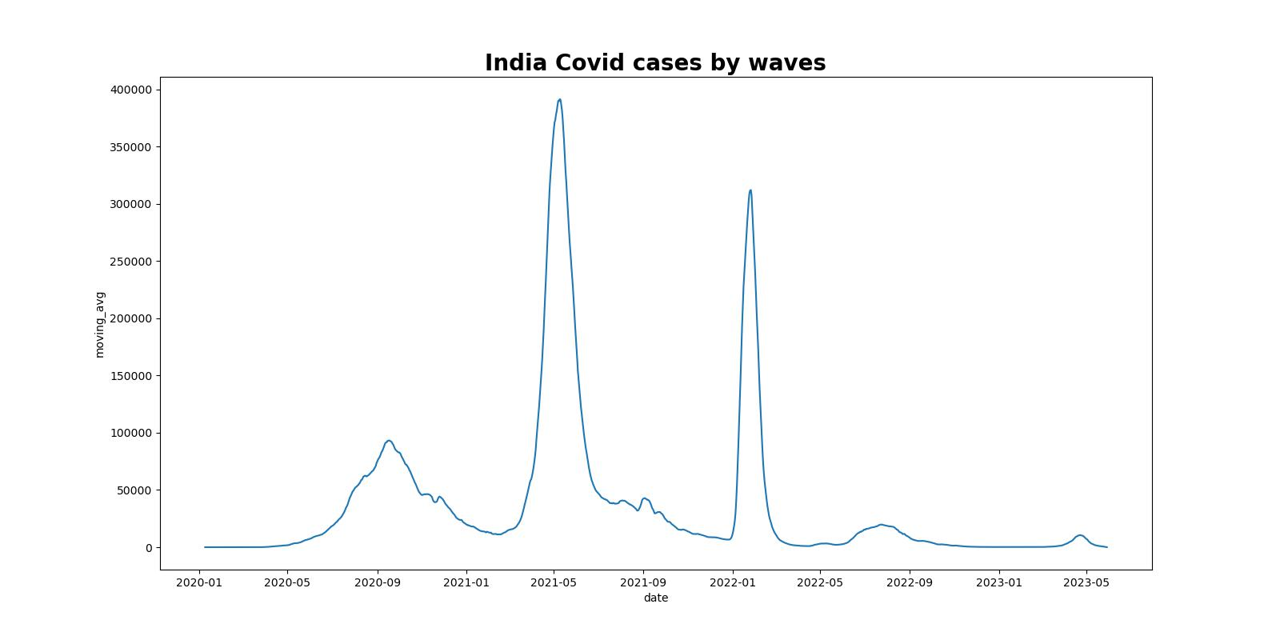

Slide 21
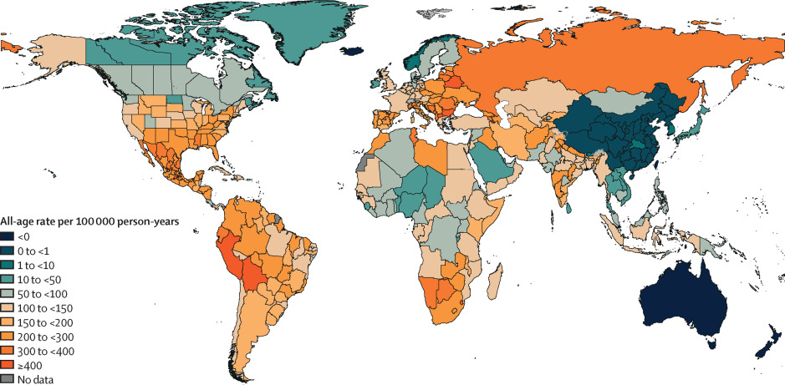
Global distribution of estimated excess mortality rate due to the COVID-19 pandemic, for the cumulative period .

Slide 22
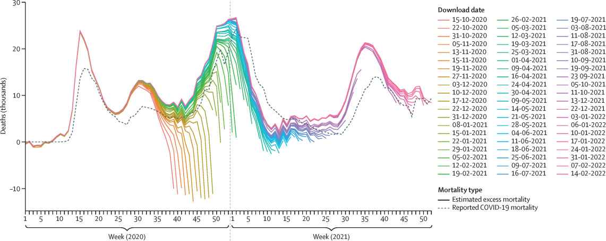
Late registration in all-cause mortality and its effect on computed excess mortality over time, USA

Slide 23

Conclusion and Recommendation :

Slide 24
1. Epidemiological Trends:
- Analyze the spread of the virus over time to identify hotspots and potential areas of concern.
- Monitor the reproductive number (R0) and the impact of different variants to guide targeted interventions.
- Use modeling and forecasting to anticipate potential future trends and prepare for different scenarios.
Recommendation:
Implement targeted interventions in areas with high transmission rates, and closely monitor areas experiencing outbreaks.
2. Vulnerable Populations:
- Identify demographic groups most vulnerable to severe outcomes from COVID-19.
- Prioritize vaccination and resource allocation based on vulnerability.
Recommendation:
Launch vaccination campaigns focusing on high-risk groups, such as elderly individuals and individuals with underlying health conditions.

Slide 25
3. Healthcare System Capacity:
- Monitor hospitalization rates, ICU admissions, and medical resource availability.
- Plan for resource allocation and surge capacity.
Recommendation:
Build healthcare system capacity to handle surges and emergencies effectively.
4. Vaccination Effectiveness:
- Analyze vaccination data to assess vaccine effectiveness and the need for booster shots.
- Monitor the overall impact of vaccination on reducing severe cases and deaths.
Recommendation:
Ensure equitable distribution of vaccines and prioritize booster shots as needed.

Slide 26
References :
Link to the Dataset : https://ourworldindata.org/covid-deaths
Link to Github account : https://github.com/SamantaRana11/CapstoneProject
https://www.frontiersin.org/articles/10.3389/fpsyg.2020.569348/full#B16
https://www.frontiersin.org/articles/10.3389/fpsyg.2020.569348/full#B24
https://www.frontiersin.org/articles/10.3389/fpsyg.2020.569348/full#B1

